Slide 1

Analysis of Adverse Drug Effects Using Big Data and Cloud Computing
Leveraging data to enhance drug safety and protect patients
Notes:
Objective: To identify and analyze patterns in adverse drug reactions to support safer prescription practices and patient care.

Slide 2
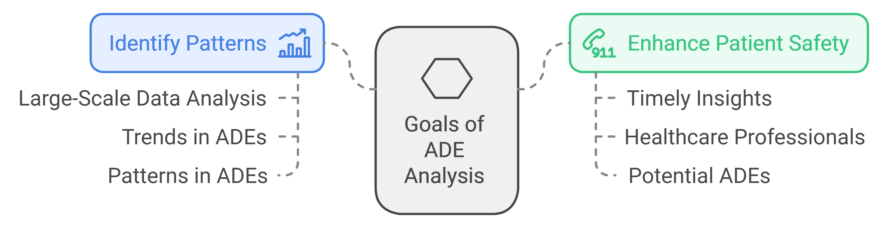
General description
Goal
Identify Patterns
Enhance Patient Safety:

Slide 3
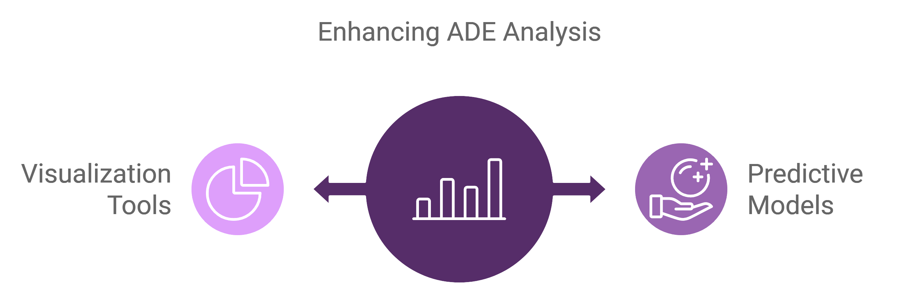
Objectives:
Data Integration: Integrate diverse data sources, such as electronic health records (EHRs), clinical trials, and patient reports, into a unified platform for comprehensive analysis.
Develop Predictive Models: Create and validate predictive models to forecast ADEs based on patient demographics, drug interactions, and historical data.
Create Visualization Tools: Develop visualization tools to help healthcare providers easily interpret data on ADEs and their impacts on patient outcomes.

Slide 4
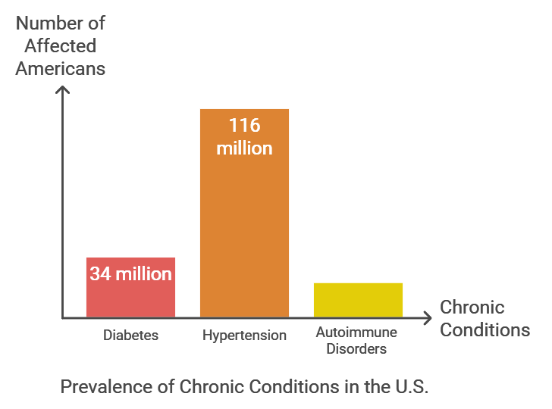
Motivation
High Medication Usage:
Approximately 70% of adults in the U.S. take at least one prescription medication.
Nearly 50% of adults take two or more medications.
Prevalence of Chronic Conditions:
Diabetes: Over 34 million Americans have diabetes, requiring ongoing medication management.
Hypertension: Nearly 116 million adults in the U.S. suffer from high blood pressure, often necessitating multiple medications.
Autoimmune Disorders: Conditions like thyroid disease affect approximately 20 million Americans.

Slide 5

Motivation
Risks of Adverse Drug Effects (ADEs):
WHO estimates that 1 in 10 patients is harmed while receiving hospital care, with ADEs as a common cause.
Up to 30% of hospital admissions are related to complications from medications.

Slide 6
Business Goal
Enhance Patient Outcomes
Reduce Healthcare Costs
Support Insurance Companies: Help insurance companies reduce claims related to ADEs, ultimately lowering their overall expenditure on patient care.
Foster Informed Decision-Making:

Slide 7

Dataset Description & Collection Process
Source of Data: FDA Adverse Event Reporting System (FAERS).
Dataset Format and Structure: Initially in JSON format, containing structured fields that detail patient demographics, drug information, and reaction types. Unique reports are identified by safetyreportid, and each report includes patient data, reaction descriptions, and drug administration details.
Conversion to CSV: Parsing JSON using Python to extract relevant columns and format them into CSV for efficient analysis and compatibility with Apache Spark.

Slide 8
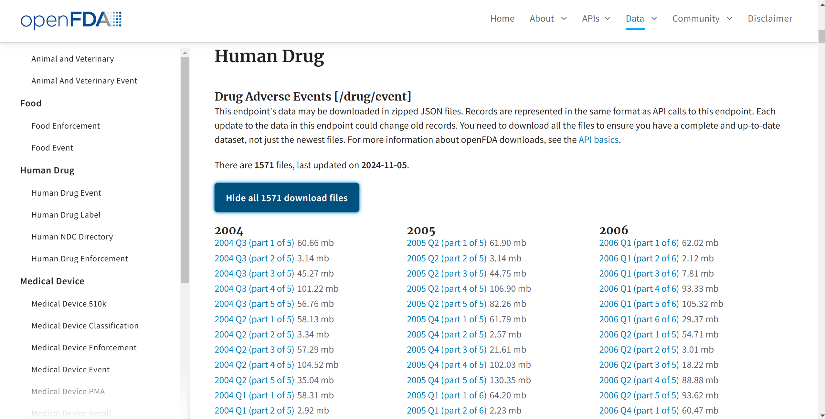

Slide 9

Key Columns and Their Definitions
1. safetyreportid - Unique identifier for each report.
2. reactionmeddrapt - Type of adverse reaction (target column).
3. medicinalproduct - Name of the drug associated with the reaction.
4. patientsex and patientonsetage - Patient demographics to help identify any gender- or age-based patterns in reactions.
5. drugdosagetext - Information on the prescribed drug dosage.
6. serious - Indicates if the reaction is classified as serious.
7. occurcountry - Country of occurrence for geographic analysis.

Slide 10

Target Column and Projected Analysis
Target Column: reactionmeddrapt (Type of Adverse Reaction).
Purpose: Classify and quantify specific types of adverse reactions.
Analysis Goals: Identify correlations between specific drugs and high-frequency reactions, examine if patient demographics influence reaction likelihood or severity.

Slide 11
Data Pipeline and Workflow
1. Data Collection - Import JSON files from FDA databases and store them in Google Cloud Storage.
3. Data Processing on Apache Spark - Utilize Spark on Google Cloud for scalable data processing and to handle the extensive size of the dataset.
4. Exploratory Data Analysis (EDA) - Analyze trends in adverse reactions by patient demographics, drug types, and dosage.
5. ML Classification Model Implementation.
5. Interpretation and Reporting - Document key findings and recommend safety measures based on observed patterns.

Slide 12

Platform Choice and Computational Tools
Cloud Platform: Google Cloud Platform (GCP) - Scalable storage, high-speed access, integration with big data tools.
Data Processing Framework: Apache Spark - Parallel processing capabilities for large datasets.
Visualization Tools: Matplotlib, Tableau for data presentation and dashboard creation.

Slide 13
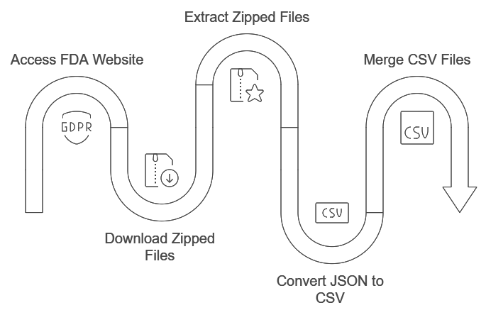
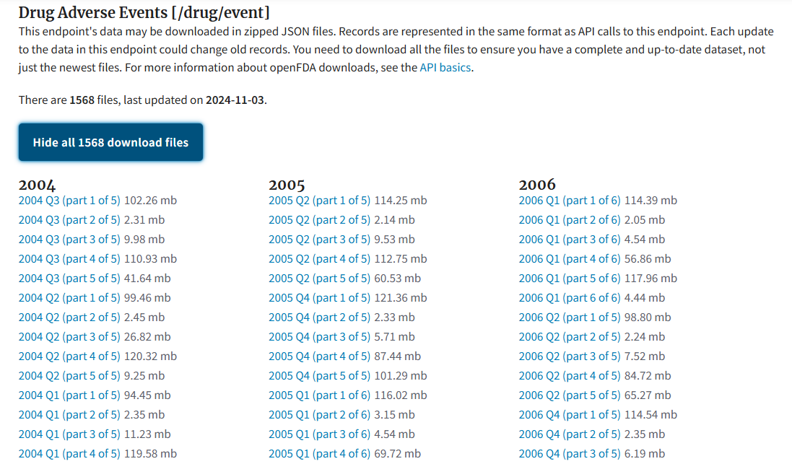
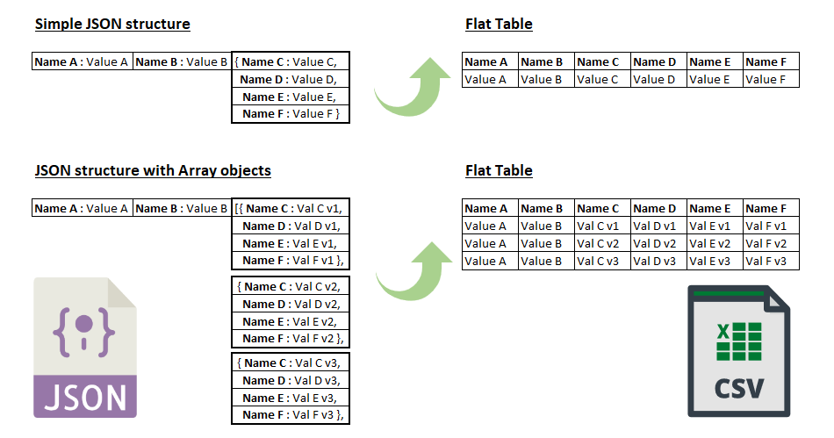

Data Collection

Slide 14
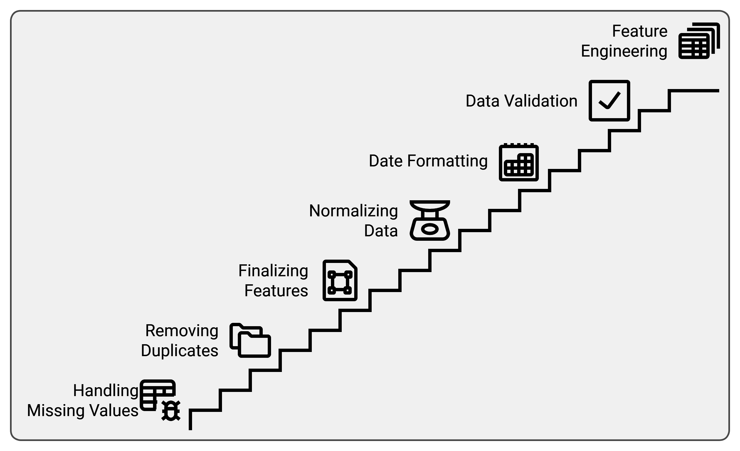
Data Cleaning & Preprocessing

Slide 15
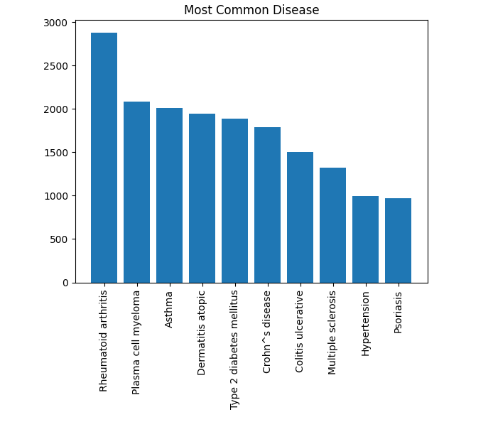
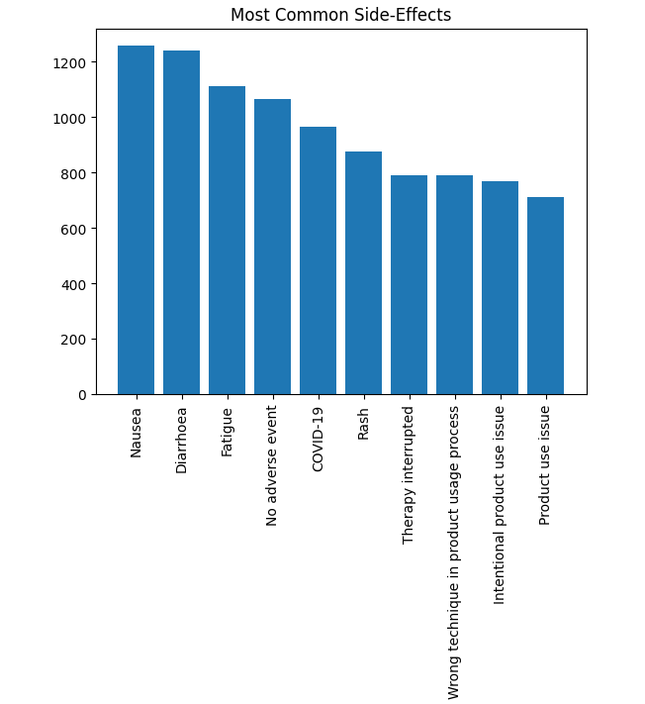
Data Visuals

Slide 16
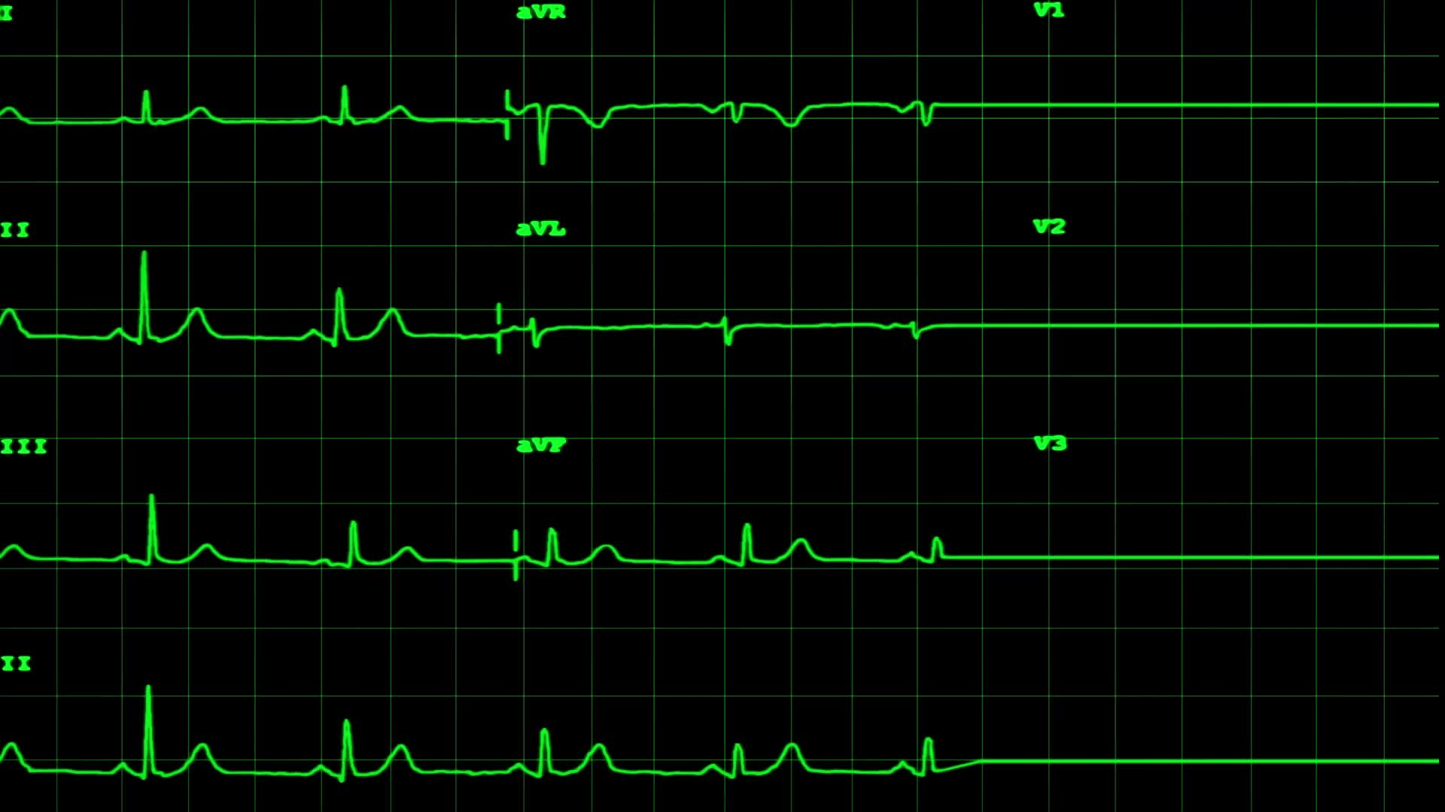
Feature Engineering Strategy and ML Models
1. Drug Dosage Effect: Calculated using drugstructuredosagenumb and drugstructuredosageunit.
2. Geographical Insight: Map ADR frequency by occurcountry.
3. Age Groups and Gender : Explore age- or gender-specific adverse effects.
4. Severity Indexing (SVI): Build a severity index using serious, seriousnesshospitalization, and seriousnesslifethreatening fields.
Classification Models: Random Forest, Gradient Boosting, Logistic regression, Neural networks.
Metrics : Precision, Recall, F1 score and Confusion Matrix.

Slide 17

Importance and Impact of the Project
Contribution to Drug Safety: Provides insights to healthcare on drug risks, highlighting high-risk drugs and potential demographic susceptibilities.
Support for Regulatory Bodies: Assists FDA and others in refining drug approval processes.
Public Health Impact: Potentially reduces ADR-related hospitalizations, improving patient safety and therapeutic effectiveness.

Slide 18

Expected Outcomes and Insights
1. Adverse Reaction Profiles - Summary of common adverse effects per drug.
2. Demographic-Based Insights - Patterns in reactions based on age and gender.
3. Risk Identification - List of high-risk drugs and doses.
4. Geographic Analysis - ADR trends by region.
5. Recommendations - Best practices for healthcare providers.

Slide 19

Challenges and Solutions
Data Complexity and Volume: Addressed by Apache Spark and GCP.
Data Inconsistencies and Missing Values: Will be resolved through rigorous data cleaning.
Interpretability of Results: Clear visualizations and summary statistics to convey insights.

Slide 20
Future Enhancements and Scalability
1. Real-Time ADR Analysis: Integrate real-time data feeds for dynamic monitoring of drug safety profiles.
2. Advanced Machine Learning Models: Explore classification models to predict high-risk cases.
3. Broader Dataset Integration: Incorporate additional data sources like lifestyle or co-morbidity information for a holistic view of ADRs.

Slide 21

Conclusion and Key Takeaways
Summary of Key Points: Comprehensive ADR analysis using big data, cloud infrastructure, and scalable processing.
Identified crucial insights on drug safety to aid clinical decision-making.
Final Thought: This project demonstrates the power of data-driven insights in enhancing drug safety, with potential to save lives and reduce healthcare costs.

Slide 22
Thank you

